Slide 1


Case #9
Daily CSI
Can you solve it?
The Music Hut
8th Grade Forensic Science
T. Trimpe 2006 http://sciencespot.net/

Slide 2
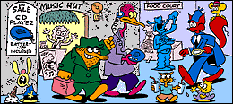
Someone stole a CD and a portable CD player from the mall music store. Shady Shrew claims he saw the stork unwrap those items and immediately start listening to music. Slylock Fox strongly suspects Shady's account is false. Why?
Hint: What is the power source for the CD player?
Source: http://www.slylockfox.com/arcade/BrainBogglers/index.html

Slide 3
Solution
The CD player needed batteries before it could be used.
Shady Shrew made up the lie. The stolen items are in his bag.

